Slide 1

Predictive Risk Score Assessment Mapping for Prevention of Gun Violence
Initial Project Idea by:
Erick Guevara

Slide 2
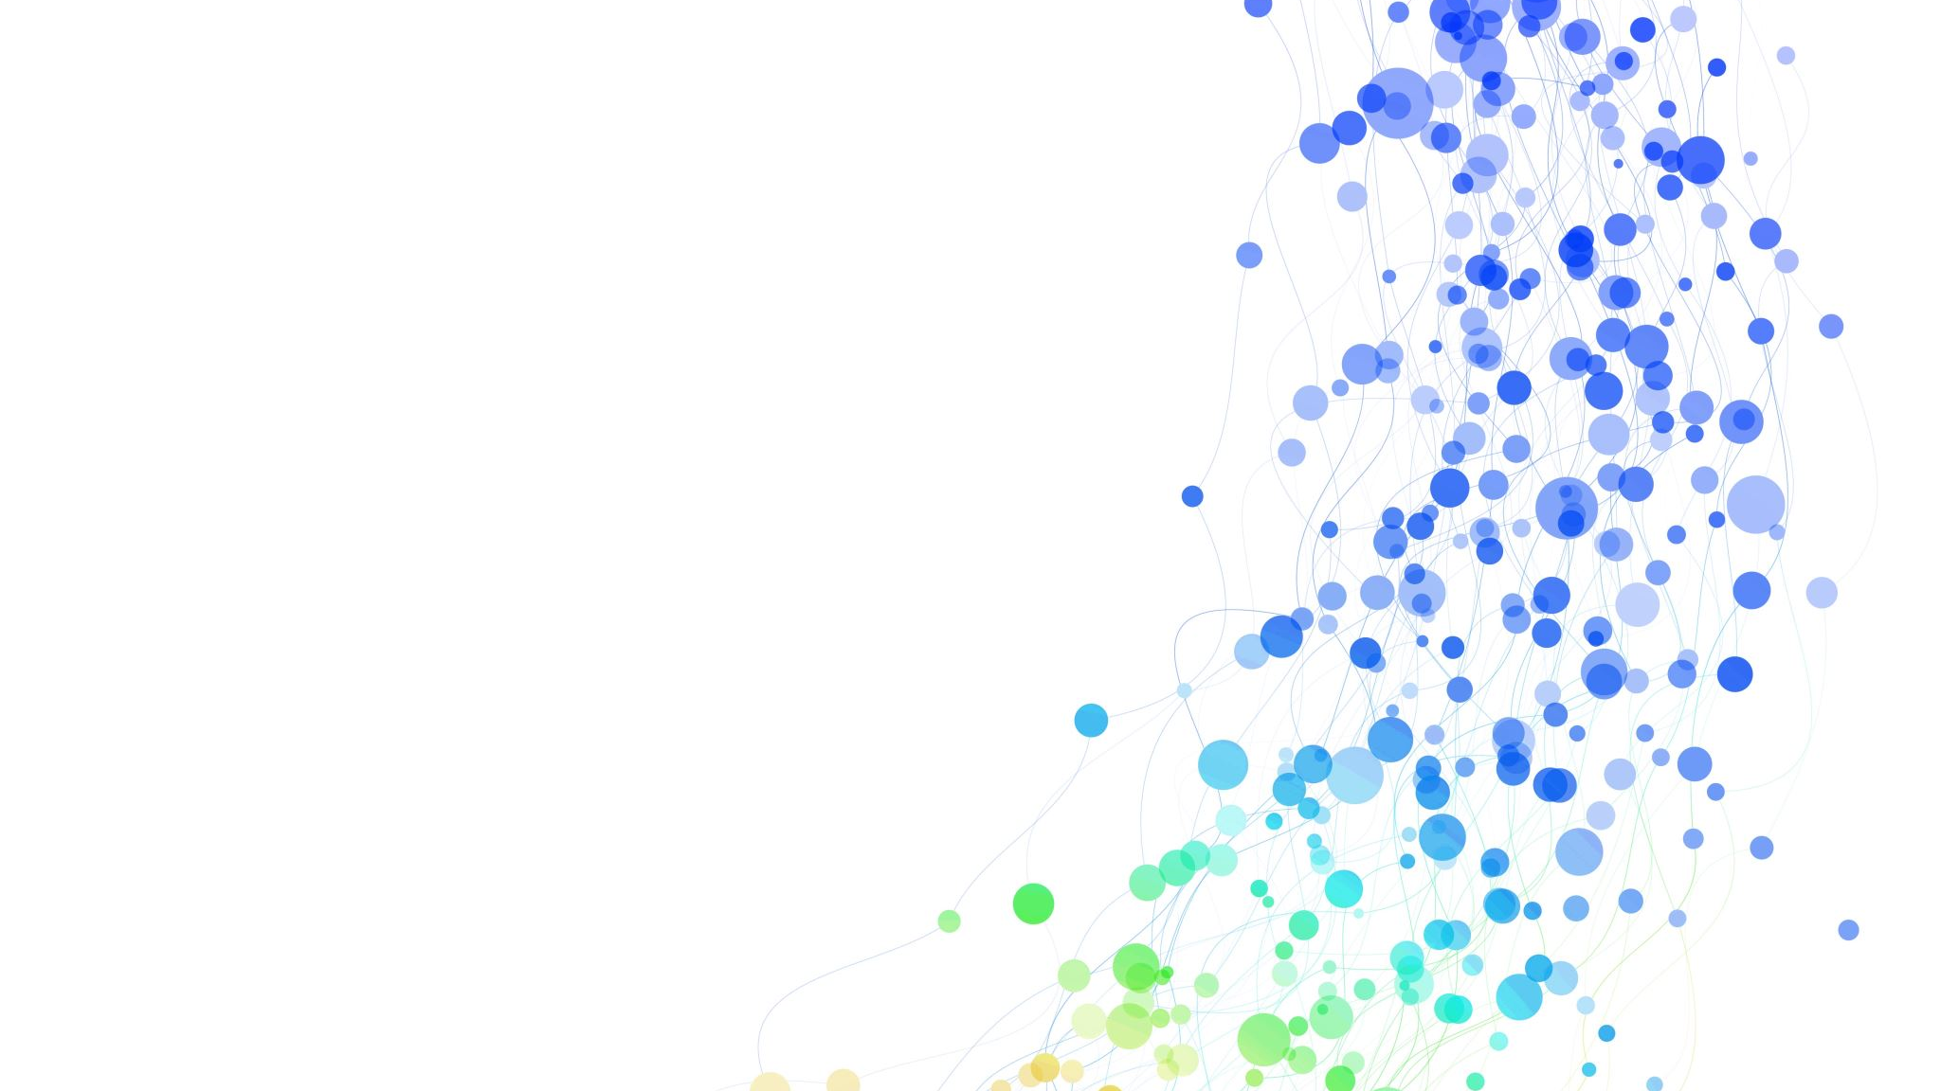
Intro Summary
There are incidents that cause harm to the public mass ranging from mass shootings, school shootings, robberies, racketeering, etc.
Currently the most efficient way to prevent these incidents from are tips that lead to preemptive investigations or arriving while the scene is active.
Creating a risk score index on locations were through demographics, crime history, and social media analysis a predictive model can be created to put a marker

Slide 3
Related Literature Reviews
Goin, D. E., Rudolph, K. E., & Ahern, J. (2018). Predictors of firearm violence in urban communities: A machine-learning approach. Health & place, 51, 61–67. https://doi.org/10.1016/j.healthplace.2018.02.013
- This paper explains a model created to find predictors of gun violence only in urban communities.
Sara B.H.,Benjamin J.,Zubi J., Max K. (2021). Machine Learning can predict shooting victimization well enough to help prevent it (NBER Working Paper No. 30170). National Bureau of Economic Research. https://doi.org/10.3386/w30170
- This paper explains that predicting shootings is possible by using Machine learning and created a neural network decision algorithm.
Wood, M. (2022, June 30). Algorithm predicts crime a week in advance, but reveals bias in police response. Biological Sciences Division | The University of Chicago. Retrieved February 22, 2023, from https://biologicalsciences.uchicago.edu/news/features/algorithm-predicts-crime-police-bias#:~:text=Data%20and%20social%20scientists%20from,advance%20with%20about%2090%25%20accuracy.
-New algorithm that can predict a cime a week in advanced but there is bias in police response and a 90% accuracy rate.

Slide 4
Process
Data Collection: The first is to gather relevant data. For this project, I may need to collect data on gun violence incidents, including the date, location, type of incident, number of victims, gun laws, socioeconomic factors, and demographic information.
Data Preparation and Cleaning: Once I have collected the data, I will need to clean and prepare it for analysis. This step involves removing any duplicates, filling in missing values, and formatting the data in a way that can be easily analyzed.
Exploratory Data Analysis: The next step is to perform exploratory data analysis to identify patterns and trends in the data. This will help identify potential variables that may be predictive of gun violence incidents, I will draft up visualization methods to help find patterns.
Feature Engineering: After identifying potential variables, I will create new features by combining or transforming existing variables. For example, a feature that calculates the number of gun violence incidents per capita for each location.
Predictive Modeling: Predictive modeling can begin once the data is cleaned, patterns have been identified, and new variables were created. Machine learning algorithms like logistic regression, time series analysis, linear regression, and/or ensemble methods to predict the likelihood of gun violence incidents based on the available data.
Crime Network Analysis: In addition to predictive modeling, I will implement a crime network analysis. This involves analyzing the relationships between different entities in the crime network, such as perpetrators, victims, and locations. Network analysis can help with identifying key nodes and patterns in the network that can inform interventions to prevent gun violence.
Visualization and Reporting: The final step is to visualize and report the findings. I could create interactive dashboards, visualizations, or reports that summarize my analysis.

Slide 5
Dataset Properties
Types of variable would include location, date, type of incidents, demographics of counties, health behaviors, gun violence, and social media posts (twitter).
There will be three different datasets that would eventually be used on one mapping system where a prediction model can be developed.
Social Media Dataset (historical posts, user, date, sentimental analysis, classification) – 5 variables
Gun Violence Dataset (location, date, incidents, fatalities, reasons, etc) – 9 variables
Demographics Dataset (mental health value, income, unemployed, schools, etc.) – 18 variables
Properties:

Slide 6
Data Summary (Demographics Dataset)
Region: state name
County: county name
Year: year of dataset
mental_health: the value of how many people have mental health problems in the county per population
mental_health_provider: value of how many providers there are in each county
ratio_mental_to_pop: value of how many providers there are per population
high_school_graduation_rate: graduation rate for each county
Unemployment: unemployment number for each county
children_poverty: value of how many children are in poverty
income_inequality : income inequality value
violent_crime_rate: The crime rate of each county
severe_housing: number of problems with housing per household
discon_youth: number of people under the age of 18 who isn’t working and in school
median_household_income: median number of income per household
Homicides: number of homicides in each county
firearm_fatalities : number of firearm fatalities
population: number of total population
rural: the percentage of rural area in the county

Slide 7
Data Summary (Gun Violence)
Date : date of when incident happened
State: The state it occurred
City: city it occurred
Address: location of incident
Killed: number of people killed
Injured: number of people injured
Incident type: what type of shooting it was

Slide 8
Dataset Citations
County Health Rankings & Roadmaps. (2020). Mental health - County Health Rankings & Roadmaps. https://www.countyhealthrankings.org/explore-health-rankings/rankings-data-documentation
Gun Violence Archive: Mass Shooting Tracker. (n.d.). Mass Shooting Tracker. http://www.massshootingtracker.org/
National Crime Victimization Survey (NCVS): Bureau of Justice Statistics. (n.d.). National Crime Victimization Survey (NCVS). https://www.bjs.gov/index.cfm?ty=dcdetail&iid=245
Emmanuel Fwerr. (2021). Gun Violence Incidents in the USA. Kaggle. Retrieved from https://www.kaggle.com/datasets/emmanuelfwerr/gun-violence-incidents-in-the-usa

